Slide 1
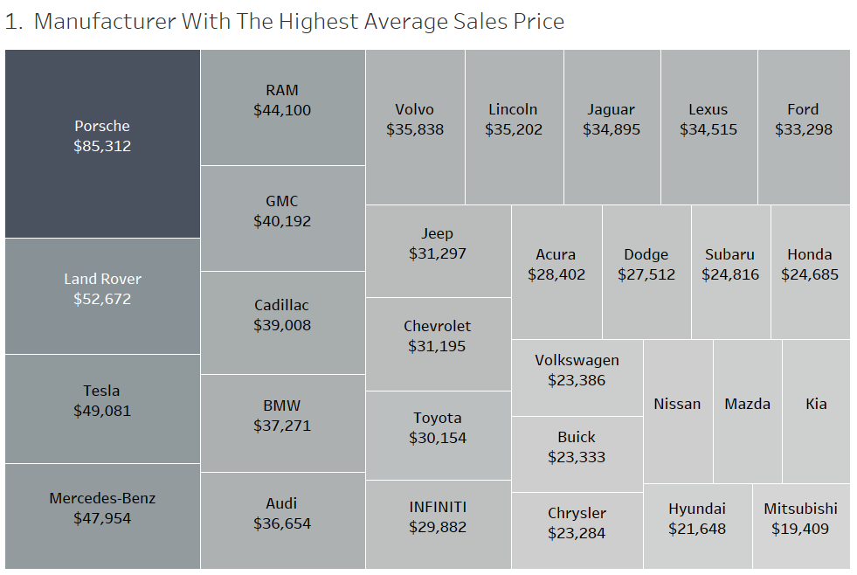

Slide 2
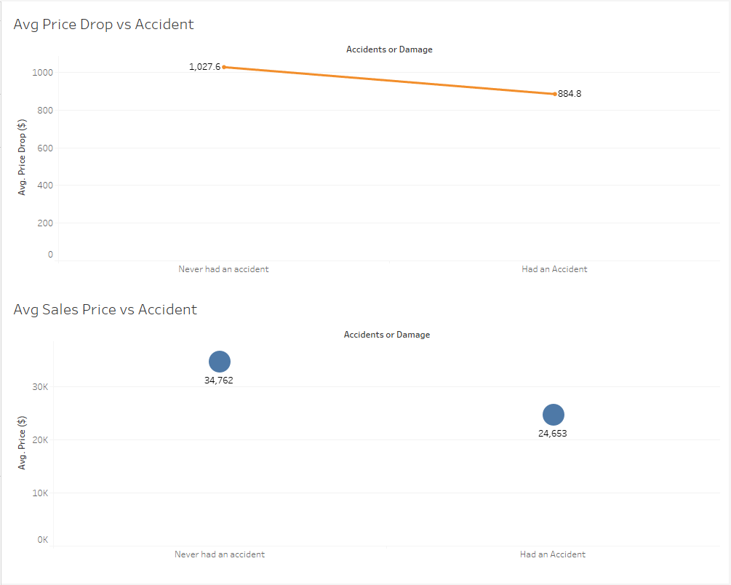

Slide 3
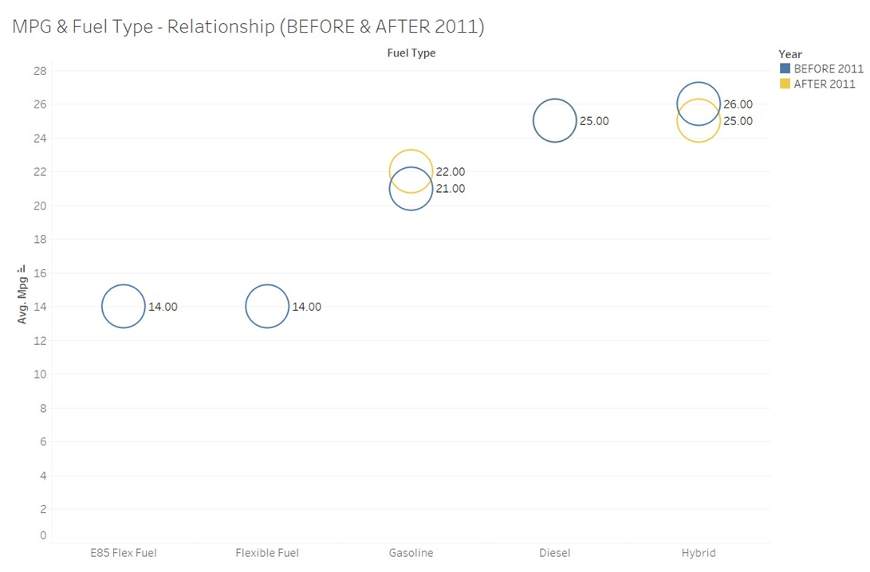
This graph compares the miles per gallon gained by used cars that use different fuels, as well as how these MPG disparities have changed over the last two decades.

Slide 4
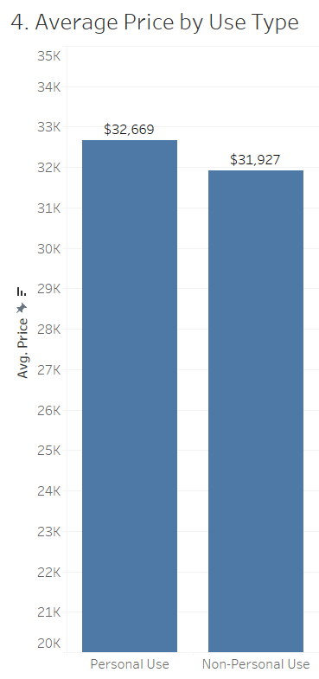

Slide 5
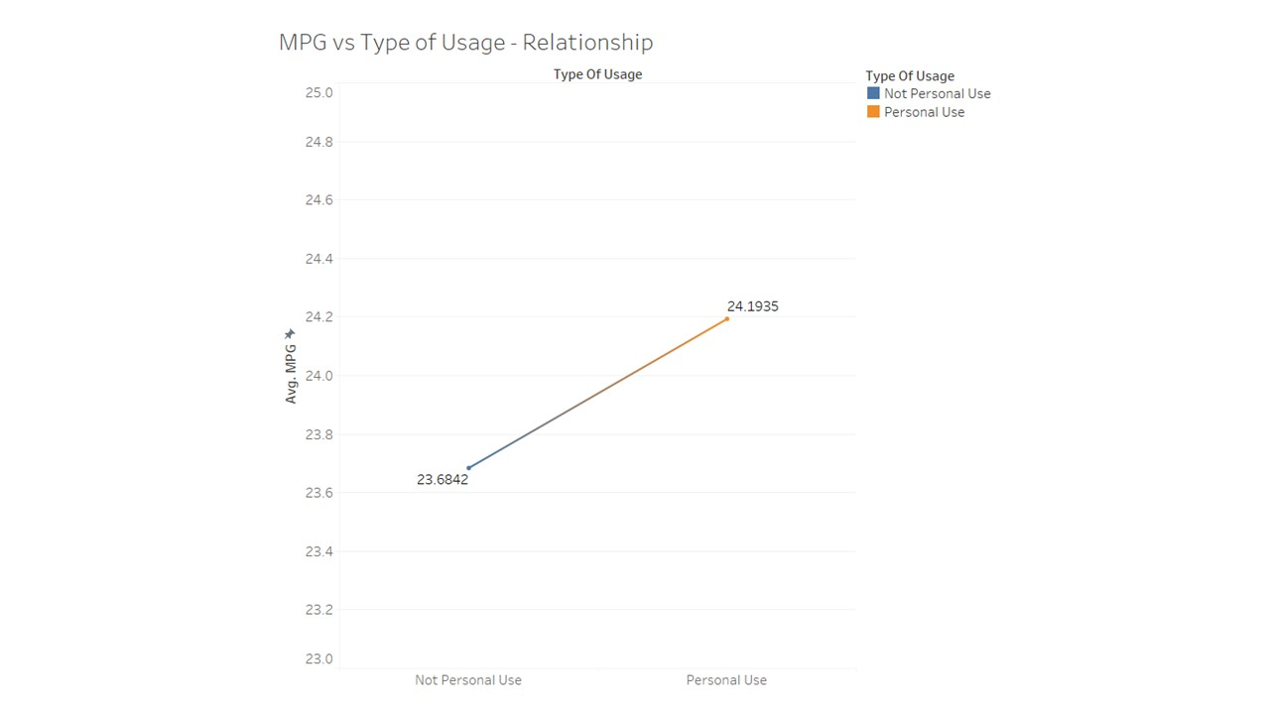

Slide 6
